Slide 1

Voice Coach
Eli ben Shimol, Yonatan shnits, Ziv cohen gvura, Nave avraham

Slide 2

Our vision
Provide An ability to practice singing
Real-time Improvement
Comprehensive Analysis
User-Centric Features
Creating a fun and engaging experience.

Slide 3
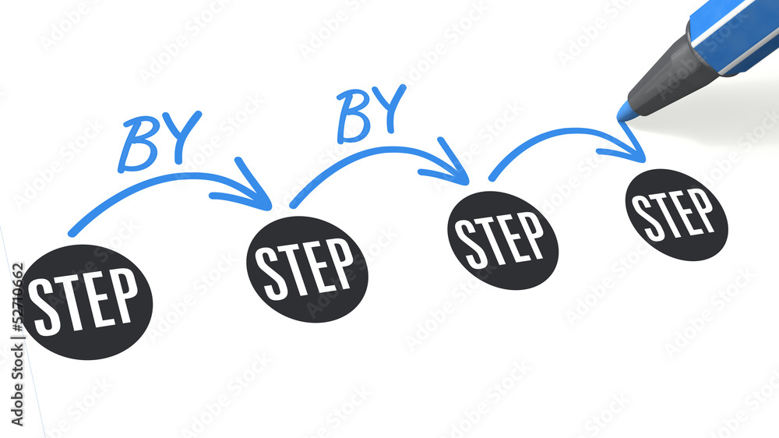
General description
Create an account
Open a new project
Upload an example recording you think is good
Record yourself performing
In depth analysis for each project
Progress analysis for the users as they add projects

Slide 4
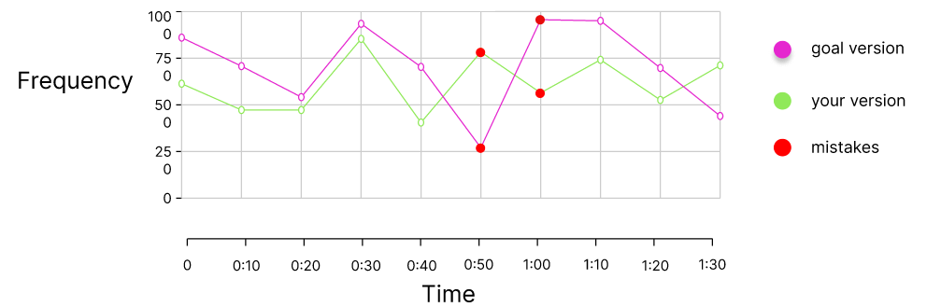
analysis examples

Slide 5
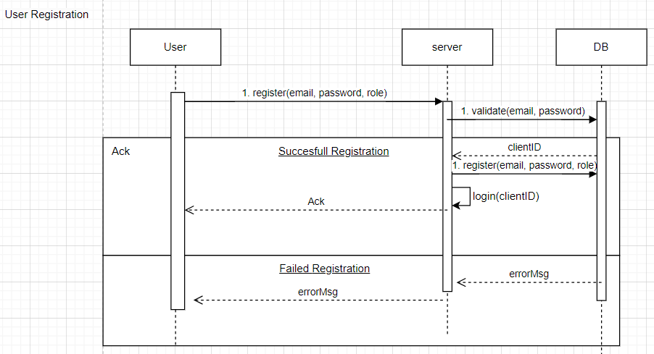
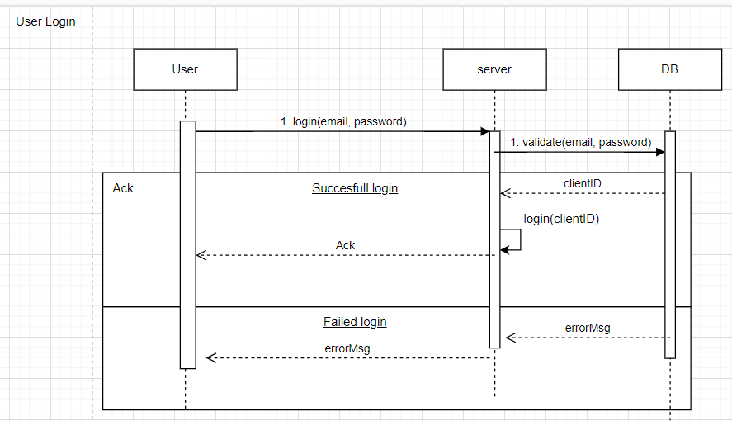
Use cases – register and login

Slide 6
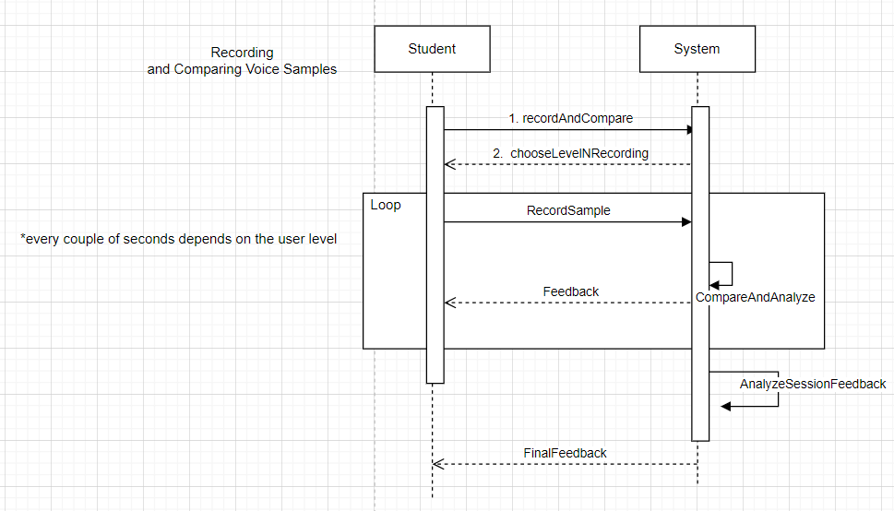
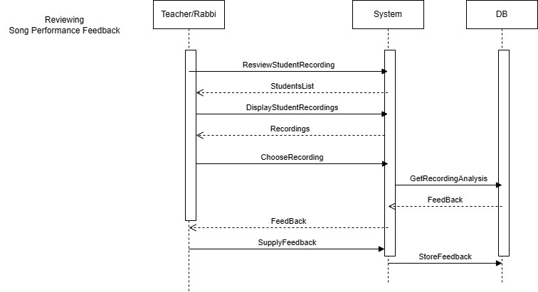
Use cases – recording and teaching

Slide 7
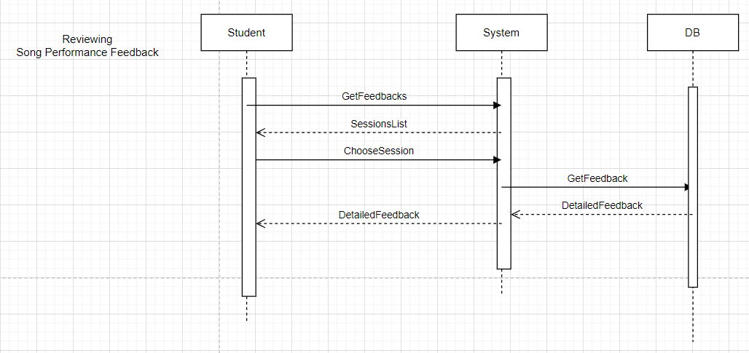
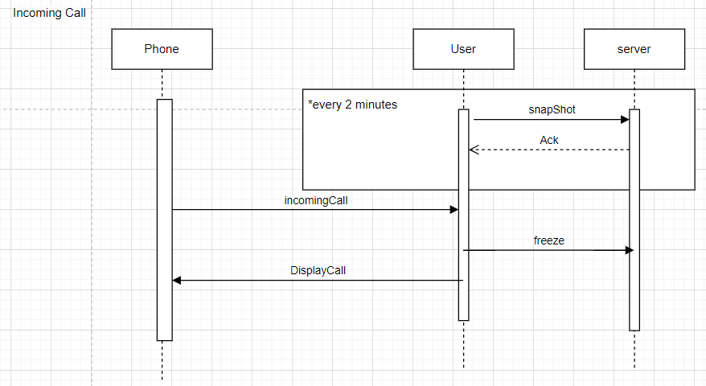
Use cases – feedback and incoming call

Slide 8

Risk assessment and proof of concept
Technical Compatibility -> compatibility tests
User Adoption -> Conduct user testing
Data Security and Privacy - > Implement encryption
Feedback Accuracy -> testing of the feedback algorithms
Real-time Voice Sampling -> Implement optimizations based on performance testing results
Understanding Hebrew -> Collaborate with language experts

Slide 9




Tools for the project

Slide 10
ui walkthrough
https://www.figma.com/proto/TLebzET0CUZ6GseieabxqB/Untitled?type=design&node-id=3-2&t=EjBoayxiP8jDkXeL-1&scaling=min-zoom&page-id=0%3A1&starting-point-node-id=1%3A2&mode=design

